Slide 1

October 2026
NEWSLETTER
Murray Hill UMC
4101 College Street
Jacksonville, FL 32205
ADDRESS CORRECTION REQUESTED
Pastor – Silas M’Mworia
Office Administrator – Ashley Allen
4101 College Street
Jacksonville, FL 32205
Phone: 904-387-4406
murrayhillumc@gmail.com
www.murrayhillumc.org
www.facebook.com/murrayhillumc/

Slide 2


The greatest support we can show is to be in prayer for one another! Please pray for your church family as needs are listed below. If you are in need of prayer, please reach out to the pastor or office.
Prayer Requests
Homebound
Dot Kight, Ken Sowers,
Mary Swearingen, Darlene Webb,
Healing & Life
Lakeshia Adside, Ella Bates, Gail Carroll,
Bonnie Ennis, Fran Meyer,
Julie Ramoutar, Unspoken Request and Needs
*Please update your prayer requests to stay current*
Please invite your neighbors, friends and family to join us for Trunk or Treat! You can share our posts on Facebook as well.
If you would like to sign up to decorate a trunk, please reach out to the church office or sign up with Meredith Robinson. Candy donations are being accepted in the church office.

Slide 3

FAITH IN ACTION
Sunday School : Sundays at 9:00 am
Worship Service: Sundays at 10:30am. See below for more information.
Food Pantry: 2nd Saturday of every month from 12:00 – 1:30 pm (or while supplies last) in the Fellowship hall
Thrift Store: Saturdays from 9:00 am – 1:00 pm in the Talbot House. Providing ministry and needed items to the community. Donations are accepted.
Hour of Prayer: Every Thursday at 6pm with Pastor Silas. (Call in Only – See Below)
Looking to Volunteer?
If you’d like to help the Ushers, please see Eric Robinson
If you’d like to help by Reading Scripture, see Janice Covert.
If you’d like to help with Food Pantry, see Meredith Robinson.
If you’d like to help with Thrift Store, see Jann Clark .
If you’re not sure where to help, or want to help in another way – call the church office. We’ll find a place for you!
Call-In: Dial 909-572-0841 When prompted enter PIN: 922029694# (Mute Phone)
Virtually: murrayhillumc.org and click the ONLINE CHURCH MEETING link
In Person: Join us in the Sanctuary at 10:30 am

Slide 4





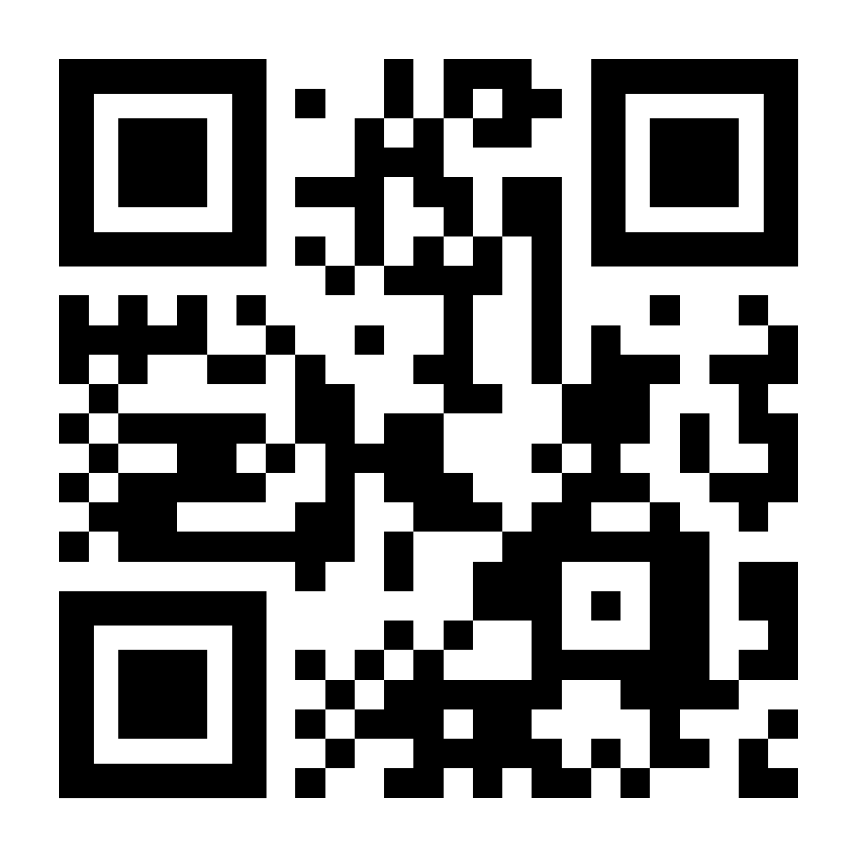
Happy Birthday
Your financial support of
MHUMC is much needed
and greatly appreciated.
We have multiple giving options for convenience:
Ken Sowers– 10/14
Cash or Check in Sunday offering plate
Mailing/dropping off check to church office
Bank Check mailed to church office
Paypal by scanning QR Code below
Don’t see your birthday or anniversary? Notify the office so we can update our records & celebrate with you!
Food Pantry Item of the Month
Please share so others can find us. You can submit items for posting by emailing murrayhillumc@gmail.com
Food Pantry Item of the Month is
Pork & Beans!

Slide 5




OCTOBER 2026
SUN | MON | TUE | WED | THUR | FRI | SAT
 |  |  |  | 1 Mary Martha Circle Hour of Prayer | 2 | 3 Thrift Store
4 Communion | 5 Chair Exercises | 6 Bridges of Harmony | 7 | 8 Young at Heart Hour of Prayer | 9 | 10 Thrift Store Food Pantry
11 | 12 Office Closed – Columbus Day | 13 Bridges of Harmony One Committee | 14 | 15 Hour of Prayer | 16 | 17 Thrift Store
18 Financial Transparency Luncheon | 19 Chair Exercises | 20 Bridges of Harmony | 21 Newsletter Due | 22 Hour of Prayer | 23 BINGO | 24 Thrift Store
25 | 26 Chair Exercises | 27 Bridges of Harmony | 28 | 29 DLC Trunk or Treat Tom Nehl Hall | 30 | 31 Thrift Store Trunk or Treat
Chair Exercises at 9:00 am Mary Marha Circle 10:45 am Hour of Prayer 6:00 pm
One Committee at 7:00 pm Young at Heart 10:30 am Thrift Store 9-1 pm
Food Pantry 12- 1

