Slide 1

July 2026
NEWSLETTER
Murray Hill UMC
4101 College Street
Jacksonville, FL 32205
ADDRESS CORRECTION REQUESTED
Pastor – Silas M’Mworia
Office Administrator – Ashley Allen
4101 College Street
Jacksonville, FL 32205
Phone: 904-387-4406
murrayhillumc@gmail.com
www.murrayhillumc.org
www.facebook.com/murrayhillumc/

Slide 2
Dear Murray Hill, United Methodist Church Family and friends,
Dear MHUMC Family,
It’s hard to believe that it has already been one year since you gave me the opportunity to serve as your Office Manager. What a year it has been, and in all the best ways. I’ve had the privilege of helping celebrate our church’s 100th Anniversary, getting to know so many of you better, come back to my home church and discovering that there is apparently no limit to the amount of snacks that can be supplied to my children.
Thank you for the lunches, the sweet treats, the surprise goodies, and the never-ending stream of snacks that somehow find their way into my boys’ hands. I’m fairly certain they think the church office is part workplace, part snack distribution center.
Thank you also for the love you have shown my family. Whether it was checking on me during my surgery last fall or praying for my boys during their surgeries this spring, you have reminded us again and again what it means to be part of a church family.
One of the greatest blessings of this job has been the flexibility to serve the church while still being present for my family. Being able to attend school events, take family trips, and enjoy those important moments with my children while continuing to serve in the office is a gift that I never take for granted.
Most of all, thank you for loving my boys. They truly feel like they have an entire congregation of extra grandparents looking out for them, cheering them on, sneaking them snacks, showing up to sporting events, and making sure they know they are loved. As a parent, there is no greater comfort than knowing your children are surrounded by people who care for them so deeply. Thank you for making this first year so memorable. Murray Hill UMC has been part of my life since I was a little girl, and getting to serve a church that has always felt like home has been a blessing beyond words.
Here's to year two!
With gratitude,
Ashley
Now the LORD is the Spirit, and where the Spirit of the LORD is, there is freedom. 2 Corinthians 3:17 (NIV)
On the Fourth of July, we as a nation celebrate our freedom from oppression. This fourth of July we are honored to celebrate our nation’s 250 birthday! Certainly, a cause worthy of our celebration, but let’s not lose sight of the bigger picture. As Christians, we celebrate a different kind of freedom every single day. It is for freedom that Christ has set us free. Stand firm, then, and do not let yourselves be burdened again by a yoke of slavery. (Galatians 5:1) We have been set free from the bondage of sin, and the Lord assures us that we never have to become entangled there again.
As we attend cookouts, munch on watermelon, and gather for parades and fireworks displays, let us keep in mind that without the Lord, the freedom that we have in this world would not be as meaningful. Our relationship with Christ frees us from fear and releases us from any shackle any human could create. It breathes new life into our souls, allowing us to make good
choices and to reap the benefits. Jesus delivers us from evil, granting the opportunity to see the world with clear eyes and share His gift of liberation with others. Be mindful that
we as Christians should make every day a celebration of the independence granted to us by the Lord as well as honor the freedoms that our fore parents has won for us.
More importantly, take the time to offer up a prayer of thanks for the one whose blood gave us freedom that not even the grave can take away. The Lord has set us free, and that is worthy of celebration every day of the year!
Happy Fourth of July Everybody.
Together Grateful for Christ and Country!
Pastor Silas

Slide 3

FAITH IN ACTION
Sunday School : Sundays at 9:00 am
Worship Service: Sundays at 10:30am. See below for more information.
Food Pantry: 2nd Saturday of every month from 12:00 – 1:30 pm (or while supplies last) in the Fellowship hall
Thrift Store: Saturdays from 9:00 am – 1:00 pm in the Talbot House. Providing ministry and needed items to the community. Donations are accepted.
Hour of Prayer: Every Thursday at 6pm with Pastor Silas. (Call in Only – See Below)
Looking to Volunteer?
If you’d like to help the Ushers, please see Eric Robinson
If you’d like to help by Reading Scripture, see Janice Covert.
If you’d like to help with Food Pantry, see Meredith Robinson.
If you’re not sure where to help, or want to help in another way – call the church office. We’ll find a place for you!
Call-In: Dial 909-572-0841 When prompted enter PIN: 922029694# (Mute Phone)
Virtually: murrayhillumc.org and click the ONLINE CHURCH MEETING link
In Person: Join us in the Sanctuary at 10:30 am

Slide 4
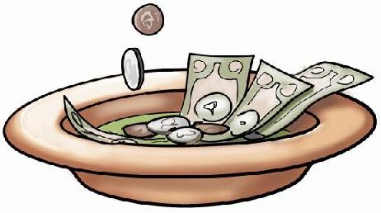




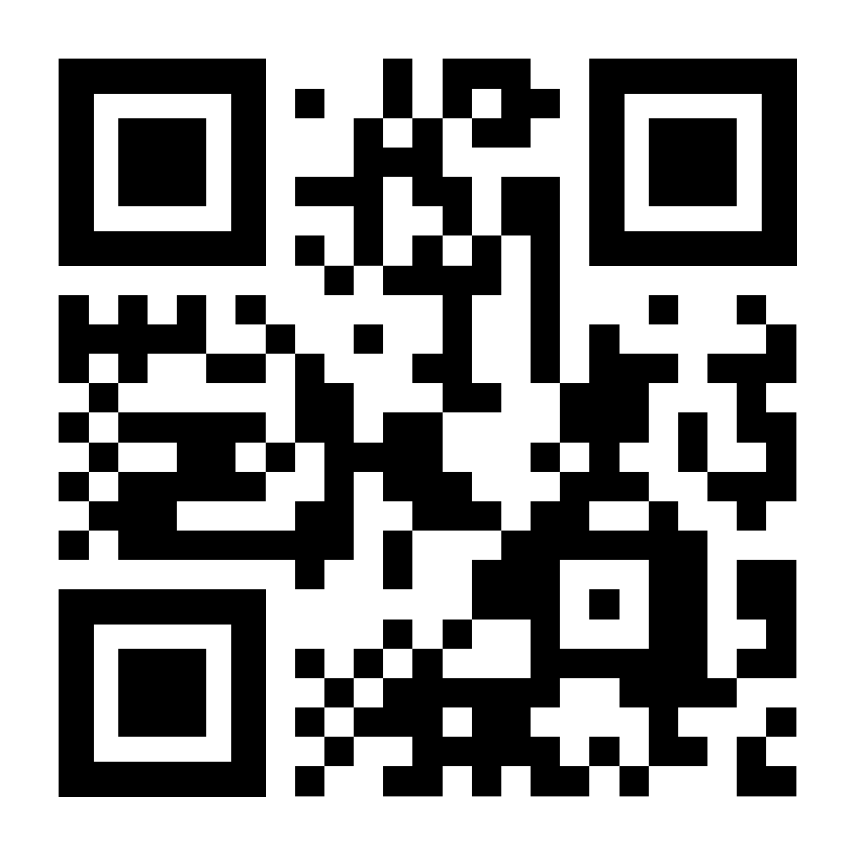
Happy Birthday
Your financial support of
MHUMC is much needed
and greatly appreciated.
We have multiple giving options for convenience:
Mary Magill – 7/13
Annon Bozeman – 7/21
Eric Robinson – 7/22
Janice Covert – 7/27
Carroll Stevenson – 7/27
Cash or Check in Sunday offering plate
Mailing/dropping off check to church office
Bank Check mailed to church office
Paypal by scanning QR Code below
Don’t see your birthday or anniversary? Notify the office so we can update our records & celebrate with you!
Food Pantry Item of the Month
For July we will be asking for donations of small jars of peanut butter!
Please share so others can find us. You can submit items for posting by emailing murrayhillumc@gmail.com

Slide 5





JULY 2026
SUN | MON | TUE | WED | THUR | FRI | SAT
 |  |  | 1 | 2 Hour of Prayer | 3 Office Closed – Independence Day | 4
5 Communion | 6 Chair Exercises | 7 | 8 | 9 Hour of Prayer | 10 | 11 Thrift Store Food Pantry
12 | 13 Chair Exercises | 14 One Committee | 15 | 16 Hour of Prayer | 17 | 18 Thrift Store
19 Newsletter Due | 20 Chair Exercises | 21 | 22 | 23 Hour of Prayer | 24 True Youth Ends | 25 Thrift Store
26 | 27 Chair Exercises | 28 | 29 | 30 Hour of Prayer | 31

