Slide 1

MAY 2026
NEWSLETTER
Murray Hill UMC
4101 College Street
Jacksonville, FL 32205
ADDRESS CORRECTION REQUESTED
Pastor – Silas M’Mworia
Office Administrator – Ashley Allen
4101 College Street
Jacksonville, FL 32205
Phone: 904-387-4406
murrayhillumc@gmail.com
www.murrayhillumc.org
www.facebook.com/murrayhillumc/

Slide 2
From the Pastors Pen…..
Dear [Recipient Name],
Warm greetings in the name of our Lord Jesus Christ! We are delighted to invite you to the 100 th Anniversary Celebration of Murray Hill
United Methodist Church.
It will be a time of reflection, celebration, and gratitude for all that God has done through our church community over 100 years. This special
service will be held on May 17th , 2026, at our church located at 4101 College Street,
Jacksonville Fl 32205.
Join us as we gather for worship, fellowship, and to give thanks for God’s faithfulness. There will be special music and heartfelt testimonies, making it an unforgettable celebration service. We’ll also take a moment to appreciate the hard work and dedication of our members who have contributed to our growth and spiritual nourishment.
We look forward to seeing you and your family for this landmark event as we honor the impact our church has made over the years. May God bless you abundantly.
Together In His Service,
Rev. Dr. Silas MMworia (Lead Pastor)
Dear Murray Hill, United Methodist Church Family and friends,
“May your (God’s) name and your remembrance continue to be the desire of our being” (Isaiah 26:8)
During this centennial year, I pray that we will closely follow the pattern laid down in the scripture. Reflecting in past but committing to the future. May our reflection on God’s great deeds in the history of Murray Hill United Methodist Church lead us to celebrate God’s goodness and commit ourselves anew to faithfully carry out God’s mission.
As we prepare to celebrate this remarkable anniversary of our church and community, it is a beautiful opportunity to reflect on our shared journey of faith and fellowship. This anniversary marks not just the passage of time, but the countless lives touched and
transformed through our collective efforts. We are excited to embrace the memories we’ve created and the future that lies ahead, filled with hope and renewed dedication.
I implore every member to delve deeper into the significance of this special occasion and explore ways to strengthen our bonds within our congregation. Secondly, let us take pride in inviting friends to join us at these centennial celebrations.
On the other side of this page, there is a sample letter to use.

Slide 3


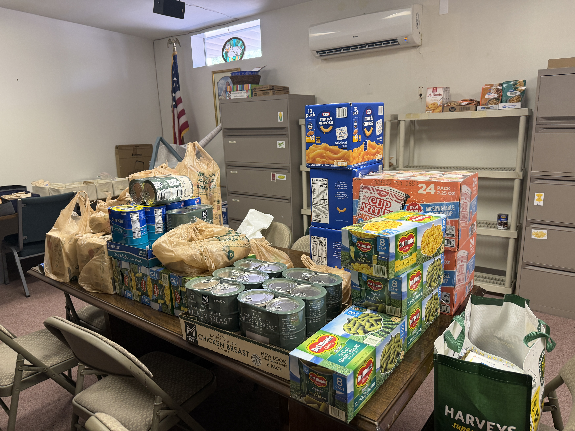
Food Pantry Item of the Month
For May we will be asking for donations of baked beans!
Thank you to Highpoint Community Church for their support of our food pantry!
100 Year Anniversary
If you have any pictures of the church from previous years, we would love to have them as part of our slideshow for the reunion. Please email them to murrayhillumc@gmail.com or contact Ashley to share any that you may have.

Slide 4

FAITH IN ACTION
Sunday School : Sundays at 9:00 am
Worship Service: Sundays at 10:30am. See below for more information.
Food Pantry: 2nd Saturday of every month from 12:00 – 1:30 pm (or while supplies last) in the Fellowship hall
Thrift Store: Saturdays from 9:00 am – 1:00 pm in the Talbot House. Providing ministry and needed items to the community. Donations are accepted.
Hour of Prayer: Every Thursday at 6pm with Pastor Silas. (Call in Only – See Below)
Looking to Volunteer?
If you’d like to help the Ushers, please see Eric Robinson
If you’d like to help by Reading Scripture, see Janice Covert.
If you’d like to help with Food Pantry, see Meredith Robinson.
If you’re not sure where to help, or want to help in another way – call the church office. We’ll find a place for you!
Call-In: Dial 909-572-0841 When prompted enter PIN: 922029694# (Mute Phone)
Virtually: murrayhillumc.org and click the ONLINE CHURCH MEETING link
In Person: Join us in the Sanctuary at 10:30 am

Slide 5






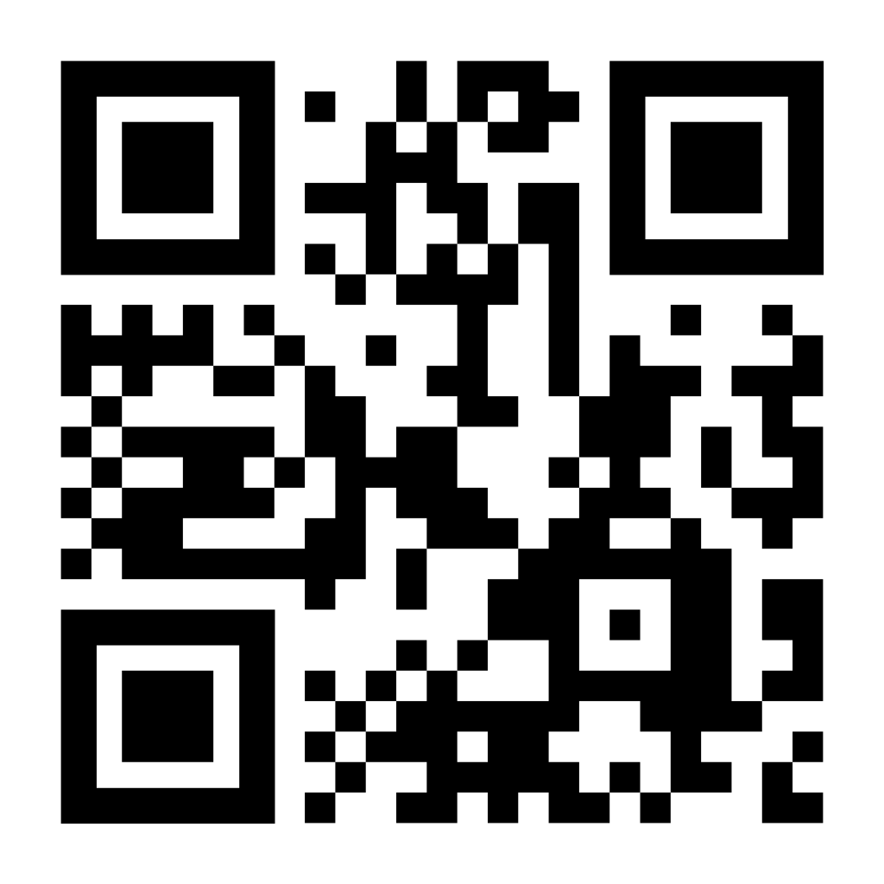
Happy Birthday
Your financial support of
MHUMC is much needed
and greatly appreciated.
We have multiple giving options for convenience:
Amy Roberts – 5/7
Lakiesha Adside – 5/19
Julia May – 5/21
Don Presley III – 5/21
Rob Meyer – 5/27
Cash or Check in Sunday offering plate
Mailing/dropping off check to church office
Bank Check mailed to church office
Paypal by scanning QR Code below
Happy Anniversary
Don’t see your birthday or anniversary? Notify the office so we can update our records & celebrate with you!
Happy Mothers Day!
Please share so others can find us. You can submit items for posting by emailing murrayhillumc@gmail.com

Slide 6








Stop by the Thrift Store
Every Saturday
9 am – 1 pm
In the Talbot House
Mary Martha Circle
May 7th at 11 am
Fellowship hall
Chair Exercise Class
Every Monday at 9:00 am
In the Fellowship Hall
Fellowship Hall
May 14th at 10:30 am
All Information for the January
newsletter is due to the
church office by
May 24th
murrayhillumc@gmail.com
Food Pantry: Saturday
May 9th from 12:00-1:30 while supplies last
ONE COMMITTEE Tuesday, May 12th at 7pm
Church Sanctuary
All are invited!
May 22nd at 6:00 pm!
Remember to Invite a friend!

Slide 7
MAY 2026
SUN | MON | TUE | WED | THUR | FRI | SAT
 |  |  |  |  | 1 | 2 Thrift Store
3 Communion | 4 Chair Exercises | 5 Bridges of Harmony | 6 | 7 Mary Martha Circle Hour of Prayer | 8 | 9 Thrift Store Food Pantry
10 Mothers Day | 11 Chair Exercises | 12 One Committee | 13 | 14 Young at Heart Hour of Prayer | 15 | 16 Thrift Store
17 Anniversary | 18 Chair Exercises | 19 Bridges of Harmony | 20 | 21 Hour of Prayer | 22 Bingo Night | 23 Thrift Store
24 | 25 Memorial Day | 26 Bridges of Harmony | 27 | 28 DLC Graduation Hour of Prayer | 29 | 30 Thrift Store
31

