Slide 1

June 2026
NEWSLETTER
Murray Hill UMC
4101 College Street
Jacksonville, FL 32205
ADDRESS CORRECTION REQUESTED
Pastor – Silas M’Mworia
Office Administrator – Ashley Allen
4101 College Street
Jacksonville, FL 32205
Phone: 904-387-4406
murrayhillumc@gmail.com
www.murrayhillumc.org
www.facebook.com/murrayhillumc/

Slide 2

Dear Murray Hill, United Methodist Church Family and friends,
We received the below letter & felt it was important to share.
On behalf of the Florida Annual Conference Council on Finance and Administration, and the many ministries made possible through connectional giving, I want to express my sincere appreciation to you and the members of your congregation. Your church’s faithful commitment in paying 100% of it’s apportioned giving in 2025 is a meaningful witness to our shared mission and ministry across the Unite Methodist church.
Apportionments represent each congregation's partnership in supporting the work of the church at the district, conference, and global levels. Because of this collective commitment, we are able to strengthen local congregations, equip clergy and lay leaders, expand outreach beyond church walls, and respond to human need in communities across Florida and around the world. Your participation helps ensure that the ministries entrusted to us continue to bear fruit in the lives of individuals, families, and communities.
We also recognize that the past several years have presented significant challenges for many congregations in the midst of these realities, Florida Conference churches demonstrated resilience and faithfulness, contributing over $9.6 million in apportionments in 2025. This achievement reflects sacrifice, stewardship and a shared belief in the power of connectional ministry. Please know that your congregation’s commitment has not gone unnoticed and is deeply appreciated.
As we look toward the future, we do so with renewed hope and purpose. Together, we remain focused on making disciples of Jesus Christ for the transformation of the world. I encourage you to share this message of gratitude with your congregation, who’s generosity and faithfulness make this ministry possible. Thank you for your leadership, partnership, and continued commitment to the mission we share.
Sincerely,
Mic Bowen,
Treasurer of the Florida Annual Conference of the United Methodist Church
Congratulations on a wonderful 100th Anniversary Celebration.
Thank you to all who helped plan, set up, clean up, prepare, prayed for, donated too, and attended the reunion!
Food Pantry Item of the Month
For May we will be asking for donations of canned veggies!

Slide 3

FAITH IN ACTION
Sunday School : Sundays at 9:00 am
Worship Service: Sundays at 10:30am. See below for more information.
Food Pantry: 2nd Saturday of every month from 12:00 – 1:30 pm (or while supplies last) in the Fellowship hall
Thrift Store: Saturdays from 9:00 am – 1:00 pm in the Talbot House. Providing ministry and needed items to the community. Donations are accepted.
Hour of Prayer: Every Thursday at 6pm with Pastor Silas. (Call in Only – See Below)
Looking to Volunteer?
If you’d like to help the Ushers, please see Eric Robinson
If you’d like to help by Reading Scripture, see Janice Covert.
If you’d like to help with Food Pantry, see Meredith Robinson.
If you’re not sure where to help, or want to help in another way – call the church office. We’ll find a place for you!
Call-In: Dial 909-572-0841 When prompted enter PIN: 922029694# (Mute Phone)
Virtually: murrayhillumc.org and click the ONLINE CHURCH MEETING link
In Person: Join us in the Sanctuary at 10:30 am

Slide 4




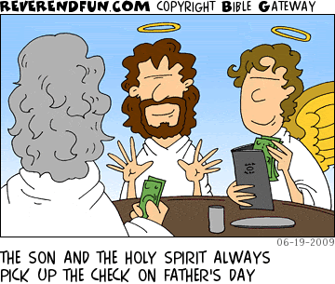
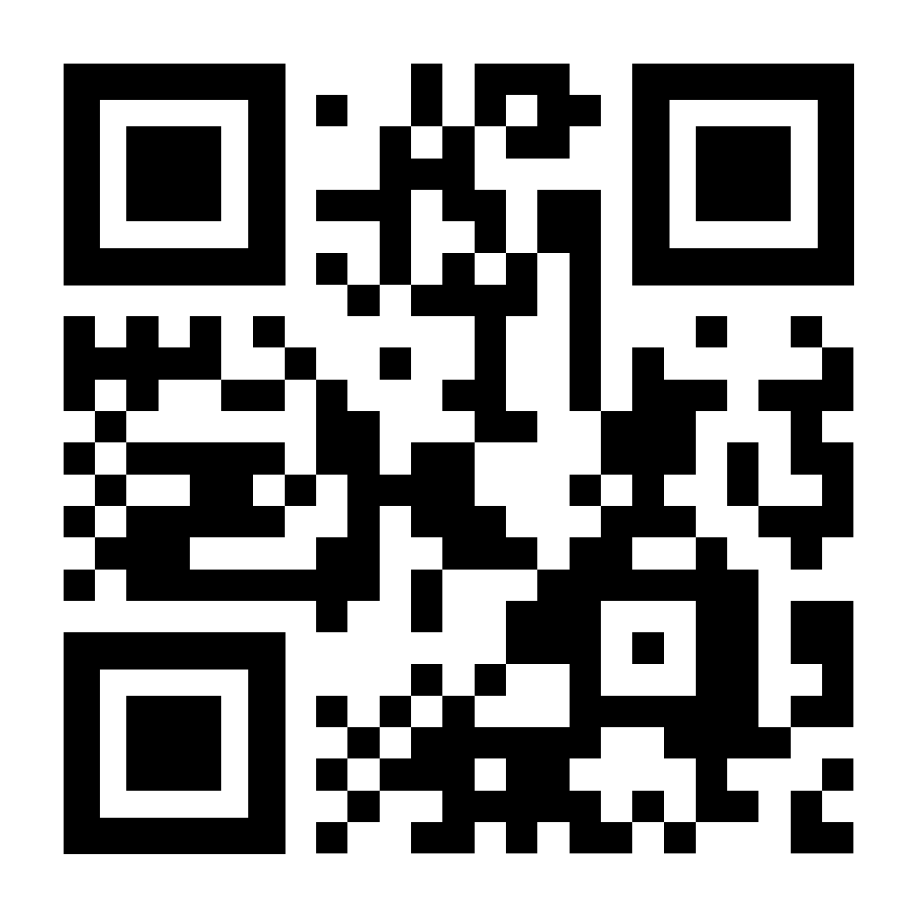
Happy Birthday
Your financial support of
MHUMC is much needed
and greatly appreciated.
We have multiple giving options for convenience:
John Robinson – 6/5
Pat Freeman – 6/15
Andrea Hester – 6/15
Darlene Webb – 6/16
Rose Palma – 6/17
Shelby Stevenson – 6/19
Fran Meyer – 6-20
Jann Clark – 6/24
Paula Pierce – 6/25
Cash or Check in Sunday offering plate
Mailing/dropping off check to church office
Bank Check mailed to church office
Paypal by scanning QR Code below
Don’t see your birthday or anniversary? Notify the office so we can update our records & celebrate with you!
Happy Fathers Day!
Please share so others can find us. You can submit items for posting by emailing murrayhillumc@gmail.com

Slide 5








Stop by the Thrift Store
Every Saturday
9 am – 1 pm
In the Talbot House
No meeting this month
Chair Exercise Class
Every Monday at 9:00 am
In the Sanctuary
Meet at Heavenly
Chocolates
June 11th at 11:00 am
All Information for the January
newsletter is due to the
church office by
June 21st
murrayhillumc@gmail.com
Food Pantry: Saturday
June 12th from 12:00-1:30 while supplies last
ONE COMMITTEE Tuesday, June 9th at 7pm
Church Sanctuary
All are invited!
No Bingo this month

Slide 6
JUNE 2026
SUN | MON | TUE | WED | THUR | FRI | SAT
 | 1 | 2 | 3 | 4 | 5 | 6 Thrift Store
7 Communion | 8 Chair Exercises True Youth Starts | 9 Bridges of Harmony One Committee | 10 | 11 Young at Heart Hour of Prayer | 12 | 13 Thrift Store Food Pantry
14 Flag Day | 15 Chair Exercises | 16 Bridges of Harmony | 17 | 18 Hour of Prayer | 19 | 20 Thrift Store
21 Fathers Day | 22 Chair Exercises | 23 Bridges of Harmony | 24 | 25 Hour of Prayer | 26 | 27 Thrift Store
28 | 29 Chair Exercises | 30 Bridges of Harmony

