Slide 1

APRIL 2026
NEWSLETTER
Murray Hill UMC
4101 College Street
Jacksonville, FL 32205
ADDRESS CORRECTION REQUESTED
Pastor – Silas M’Mworia
Office Administrator – Ashley Allen
4101 College Street
Jacksonville, FL 32205
Phone: 904-387-4406
murrayhillumc@gmail.com
www.murrayhillumc.org
www.facebook.com/murrayhillumc/

Slide 2

Dear Murray Hill Church Family and Friends,
I want to know Christ and the power of His resurrection and the fellowship of sharing in His sufferings, becoming like Him in His death, and so, somehow, to attain to the resurrection from the dead. Not that I have already obtained all this, or have already been made perfect, but I press on to take hold of that for which
Christ Jesus took hold of me. Philippians 3:10-12 (NIV)
Easter is upon us and it is a wonderful occasion for all Christians. As we prepare to celebrate this glorious day, I wanted to take a moment to remind us of this. As you all know, this is not just a day of colored eggs. It is the day that marks the resurrection of our Lord and Savior, Jesus Christ, after His crucifixion. Christ endured unimaginable suffering on the cross, sacrificing His life for ours. He was then resurrected to assure us of His eternal life, and we should all embrace this powerful example from our Lord and savior Jesus Christ. In our Lenten journey we saw that, Jesus wept with those he loved, and he still does. He raised people up, and He still does. He included others in the healing process, and He still does. I ask that you take this Easter season to think about how you can rededicate yourself to God and your brothers and sisters in Christ. As Christ rose from His mortal tomb, we should always be searching for ways to rise above the things in life that hold us back from being the persons God intended us to be. Ways to unbind those who Jesus has resurrected from the tombs of life. Let His story be the inspiration for you to break free the chains that bind you spiritually so that you may be free to unbind others who are bound by the powers of Satan. Easter is a time of celebration, celebrating our Lord and what better way to rejoice in Jesus’ gift than to ask him to renew us as He renewed Himself?
May the blessings and love of Easter be upon you, my friends.
Together in Christ’s service,
Pastor Silas
100 Year Anniversary
If you have any pictures of the church from previous years, we would love to have them as part of our slideshow for the reunion. Please email them to murrayhillumc@gmail.com or contact Ashley to share any that you may have.

Slide 3

FAITH IN ACTION
Sunday School : Sundays at 9:00 am
Worship Service: Sundays at 10:30am. See below for more information.
Food Pantry: 2nd Saturday of every month from 12:00 – 1:30 pm (or while supplies last) in the Fellowship hall
Thrift Store: Saturdays from 9:00 am – 1:00 pm in the Talbot House. Providing ministry and needed items to the community. Donations are accepted.
Hour of Prayer: Every Thursday at 6pm with Pastor Silas. (Call in Only – See Below)
Looking to Volunteer?
If you’d like to help the Ushers, please see Eric Robinson
If you’d like to help by Reading Scripture, see Janice Covert.
If you’d like to help with Food Pantry, see Meredith Robinson.
If you’re not sure where to help, or want to help in another way – call the church office. We’ll find a place for you!
Call-In: Dial 909-572-0841 When prompted enter PIN: 922029694# (Mute Phone)
Virtually: murrayhillumc.org and click the ONLINE CHURCH MEETING link
In Person: Join us in the Sanctuary at 10:30 am

Slide 4





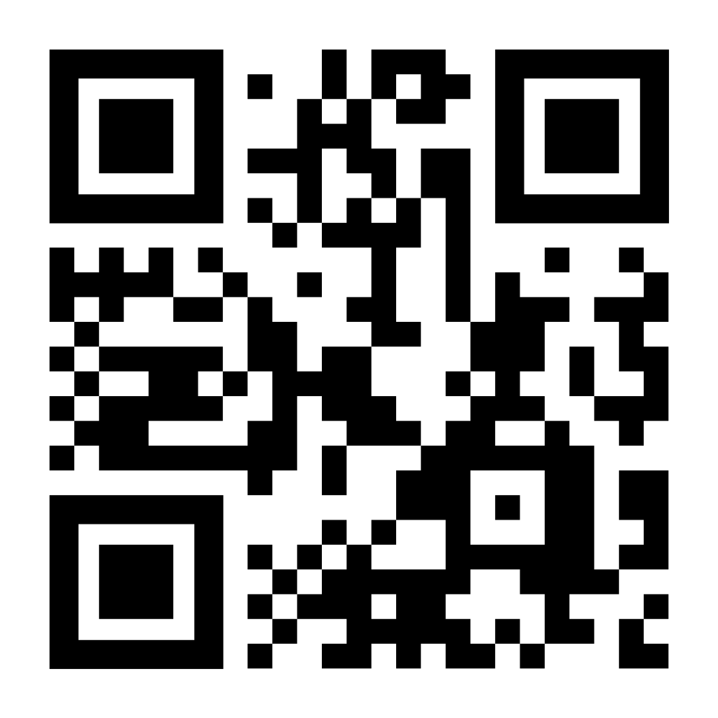

Happy Birthday
Your financial support of
MHUMC is much needed
and greatly appreciated.
We have multiple giving options for convenience:
Pastor Sila – 4/1
Thelma Adside – 4/23
Vicki McVey – 4/23
Rheta Voss – 4/24
Rev. Barry Andrews – 4/30
Cash or Check in Sunday offering plate
Mailing/dropping off check to church office
Bank Check mailed to church office
Paypal by scanning QR Code below
Happy Anniversary
Willis & Darlene Webb -4/28
Don’t see your birthday or anniversary? Notify the office so we can update our records & celebrate with you!
Food Pantry Item of the Month
This month we are kicking off our Food Pantry Item of the month. For our first month we will be asking for donations of mac n cheese!
Please share so others can find us. You can submit items for posting by emailing murrayhillumc@gmail.com

Slide 5








Stop by the Thrift Store
Every Saturday
9 am – 1 pm
In the Talbot House
Mary Martha Circle
April 2nd at 11 am
Fellowship hall
Chair Exercise Class
Every Monday at 9:00 am
In the Fellowship Hall
Fellowship Hall
April 9th at 10:30 am
All Information for the January
newsletter is due to the
church office by
April 22nd
murrayhillumc@gmail.com
Food Pantry: Saturday April 11th from 12:00-1:30 while supplies last
ONE COMMITTEE Tuesday, April 14th at 7pm
Church Sanctuary
All are invited!
April 24that 6:00 pm!
Remember to Invite a friend!

Slide 6
APRIL 2026
SUN | MON | TUE | WED | THUR | FRI | SAT
 |  |  | 1 April Fools Day | 2 Holy Thursday Mary Martha Circle Hour of Prayer | 3 Good Friday | 4 Thrift Store
5 Communion Easter | 6 Chair Exercise | 7 Bridges of Harmony | 8 | 9 Young at Heart Hour of Prayer | 10 | 11 Thrift Store Food Pantry
12 | 13 Chair Exercise | 14 Bridges of Harmony One Committee | 15 | 16 Hour of Prayer | 17 | 18 Thrift Store Bridges of Harmony
19 | 20 Chair Exercise | 21 Bridges of Harmoney | 22 | 23 Nehl Trucking Hour of Prayer | 24 Bingo | 25 Thrift Store
26 | 27 Chair Exercise | 28 Bridges of Harmoney | 29 | 30 Hour of Prayer

